Slide 1

Resume Parser Using Nlp & Clustering
BY :
Afnan Alshehri
Amena Algroon

Slide 2
TABLE OF CONTENTS
01
INTRODUCTION
02
DATA ANALYSIS
02
03
TOPIC MODELING
04
CLUSTERING
05
MODELS

Slide 3
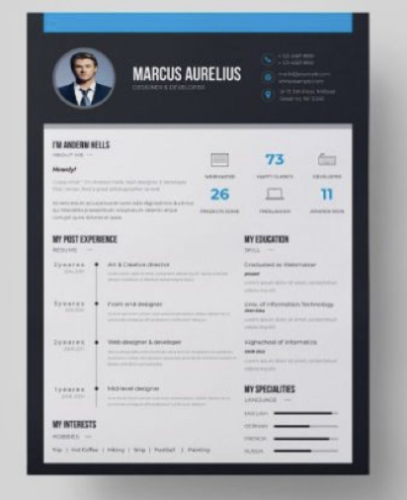
Backstory :
A resume is a formal document that serves to show a person's career background and skills.
The purpose of this project is to help large companies to scan and filter resumes.
So we will use machine learning algorithms (NLP) to help them .

Slide 4








DATASET
TOOLS
The dataset from Kaggle https://www.kaggle.com/ and github
columnshttps://github.com/shhdSU/
Before cleaning 1388 rows and 3
After cleaning 1297 rows and 2 columns

Slide 5
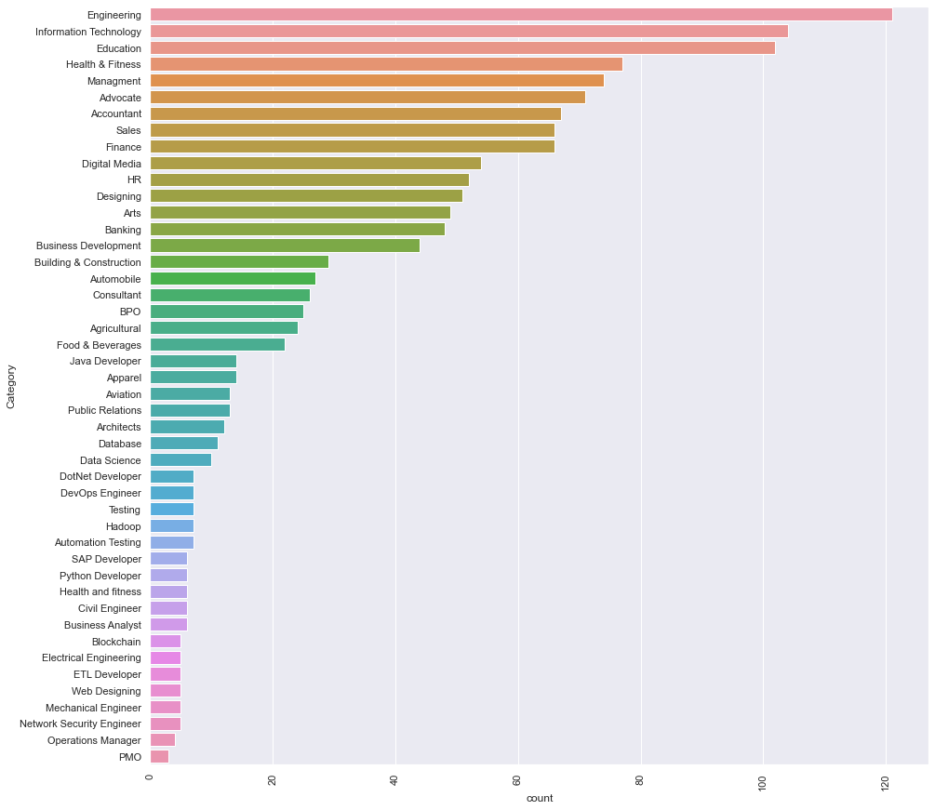
EDA
The highest resume was for the engineering major

Slide 6

EXPLORATORY ..
EXPLORATORY DATA ANALYSIS
NO Null Values
Duplicates (169 )
Data Cleaning
- Vectorization
- Removed Unneeded Column (ID)

Slide 7
Natural language processing
Text Cleaning
Tokenization.
Vectorization (TFIDF).
Removed digits from texts.
Made all text lowercase.
Removed all punctuation.

Slide 8
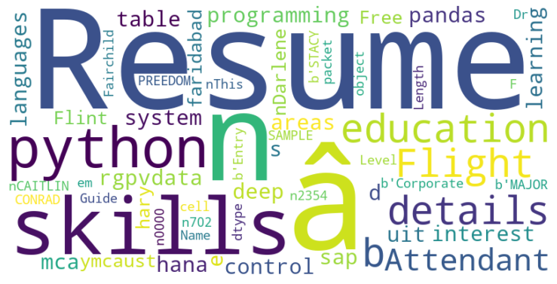
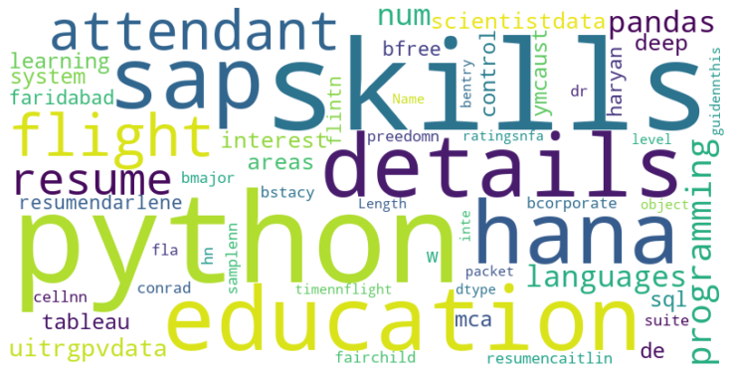
WordCloud Most Common Words
Before stopword
After stopword

Slide 9

TOPIC MODELING
LSA
Topic 1
java software developer design application server development
Topic 2
company customer business sql reports team
LDA
Topic 1
web java software developer sql application design
Topic 2
sales marketing customer product business market service
NMF
Topic 1
project management business company development system manager
Topic 2
sales business management market program financial manager

Slide 10
Classification Models
Naif Bayes
Training Accuracy : 0.63
Random forest
Training Accuracy:0.053

Slide 11
Classification Models
SVM With Count Vectorizer
Accuracy :0.5461538461538461
SVM With TF-IDF Vectorizer
Accuracy : 0.6423076923076924

Slide 12
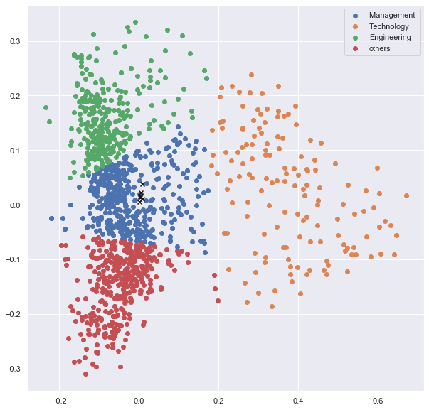
CLUSTERING:K-mean

Slide 13
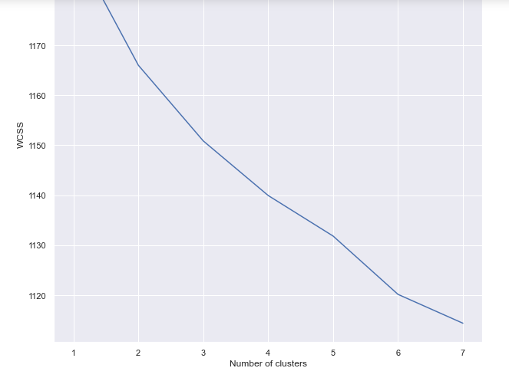
CLUSTERING:K-mean

Slide 14
Thank You
The End

